Slide 1
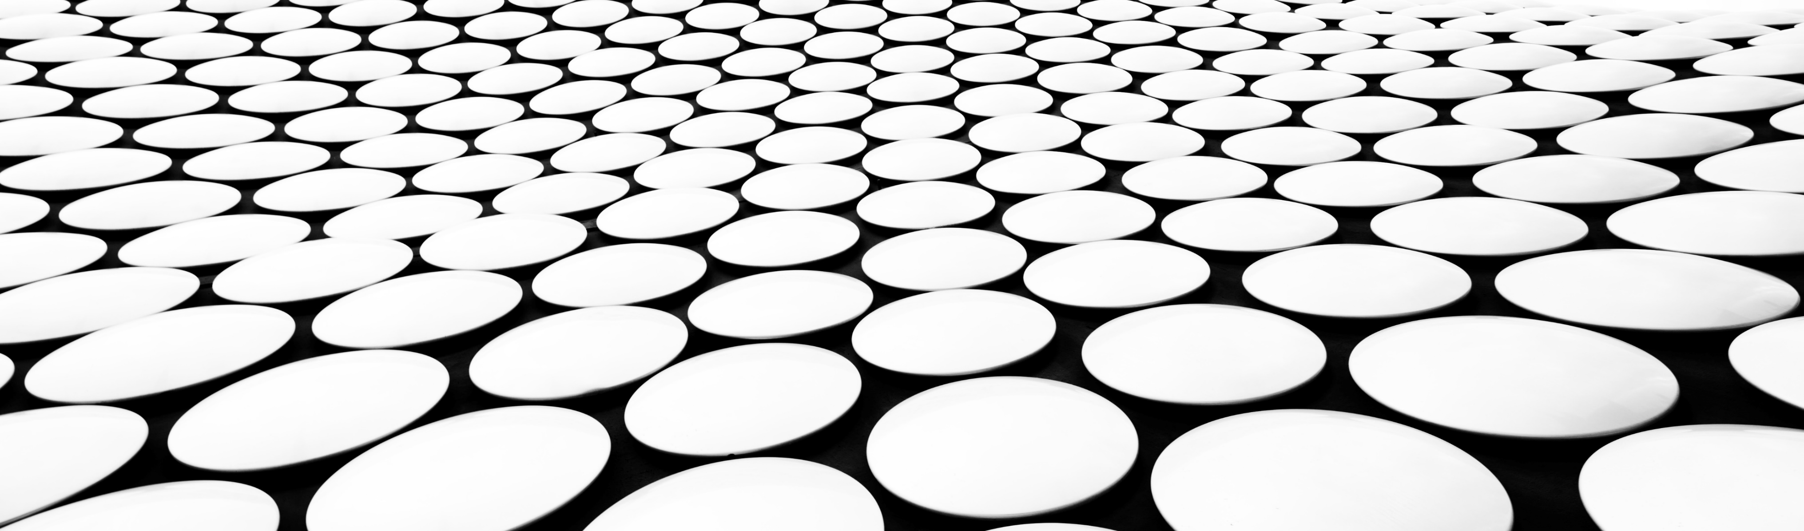
MediaPipe Face Mesh
By Bekenova Aruzhan

Slide 2
Overview
MediaPipe Face Mesh is a face geometry solution that estimates 468 3D face landmarks in real-time even on mobile devices. It employs machine learning (ML) to infer the 3D surface geometry, requiring only a single camera input without the need for a dedicated depth sensor. Utilizing lightweight model architectures together with GPU acceleration throughout the pipeline, the solution delivers real-time performance critical for live experiences.

Slide 3
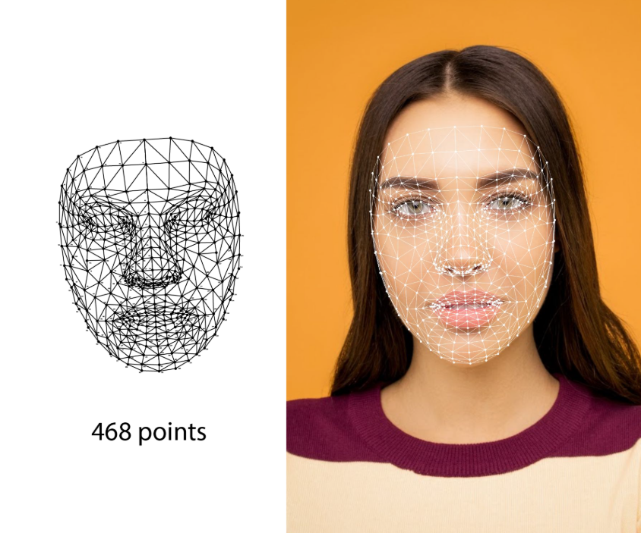
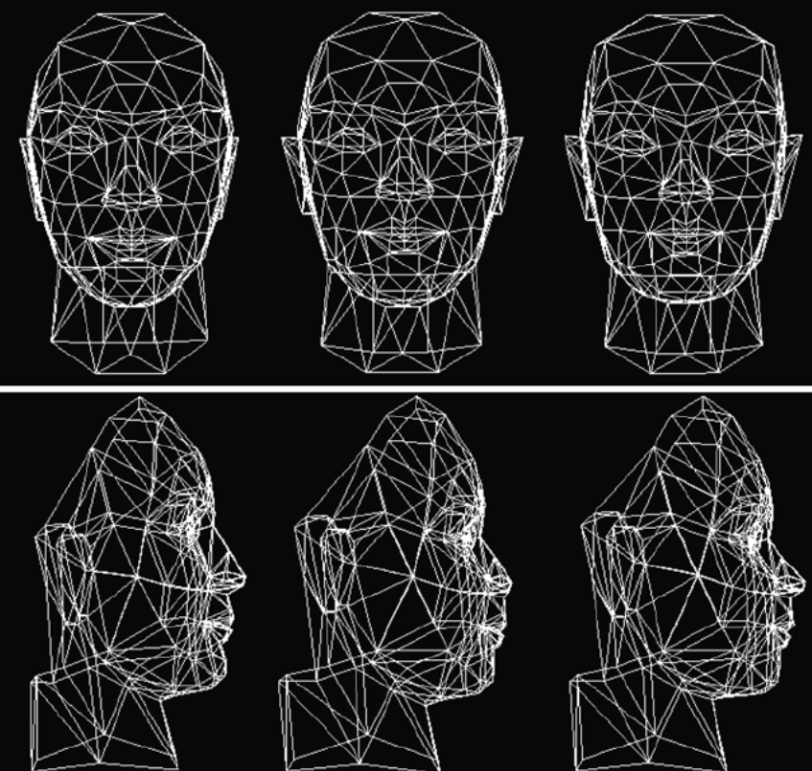
The 3D landmark network receives as input a cropped video frame without additional depth input. The model outputs the positions of the 3D points, as well as the probability of a face being present and reasonably aligned in the input.

Slide 4
Components
The Geometry Pipeline is a key component, which is responsible for estimating face geometry objects within the Metric 3D space. On each frame, the following steps are executed in the given order:
Face landmark screen coordinates are converted into the Metric 3D space coordinates
Face pose transformation matrix is estimated as a rigid linear mapping from the canonical face metric landmark set into the runtime face metric landmark set in a way that minimizes a difference between the two
A face mesh is created using the runtime face metric landmarks as the vertex positions (XYZ), while both the vertex texture coordinates (UV) and the triangular topology are inherited from the canonical face model.

Slide 5
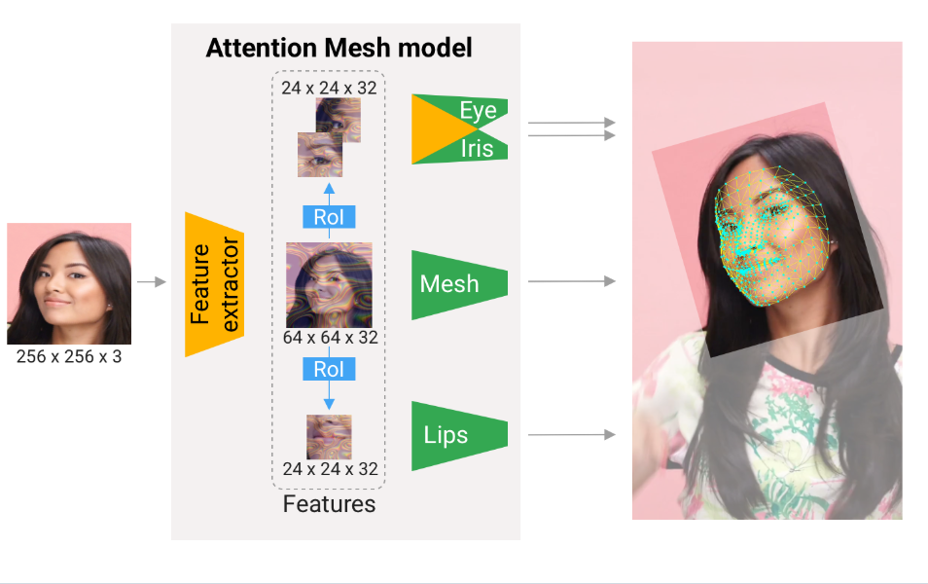
Attention Mesh Model
In addition to the Face Landmark Model we provide another model that applies attention to semantically meaningful face regions, and therefore predicting landmarks more accurately around lips, eyes and irises, at the expense of more compute. It enables applications like AR makeup and AR puppeteering.
The attention mesh model can be selected in the Solution APIs via the refine_landmarks option. You can also find more information about the model in this paper.

Slide 6
import cv2
import mediapipe as mp
import numpy as np
mp_face_mesh = mp.solutions.face_mesh
mp_drawing = mp.solutions.drawing_utils
cap = cv2.VideoCapture(0) with mp_face_mesh.FaceMesh(max_num_faces=1, refine_landmarks=True) as face_mesh:
while cap.isOpened():
ret, frame = cap.read()
if not ret:
break
rgb_frame = cv2.cvtColor(frame, cv2.COLOR_BGR2RGB)
results = face_mesh.process(rgb_frame) if results.multi_face_landmarks:
for face_landmarks in results.multi_face_landmarks:
mp_drawing.draw_landmarks(
frame, face_landmarks, mp_face_mesh.FACEMESH_TESSELATION
) cv2.imshow("Face Mesh", frame) if cv2.waitKey(1) & 0xFF == ord("q"):
break cap.release()
cv2.destroyAllWindows()

Slide 7
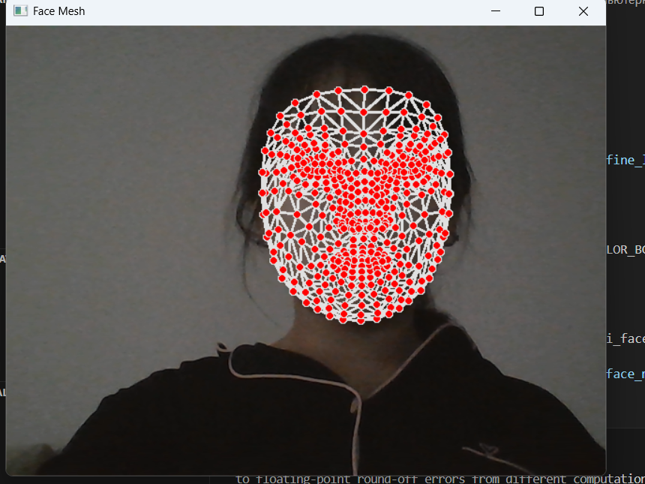
Example
This code performs real-time tracking of facial landmarks using a MediaPipe Face Mesh using a webcam. It captures the video stream, converts the frames to RGB format and transmits them to the model for processing. If a face is detected, the program overlays a grid of facial landmarks using FACE MESH_TESSELATION, visualizing the key points of the face. The display continues until the "q" key is pressed, after which video capture stops and all windows close.

Slide 8
Conclusion
MediaPipe Face Mesh is an advanced facial landmark detection solution that allows real—time tracking of 468 key facial points without using depth sensors. The model is based on neural network algorithms that provide high accuracy and performance even on mobile devices. The sample code used in the presentation demonstrates how to easily visualize a face grid on a video image taken from a camera. This opens up vast possibilities for applications in AR, animation, biometrics, and medical technology. The presentation also includes diagrams and diagrams illustrating the architecture of the model, its main stages of operation and examples of application in the industry.

